Slide 1
ELEC 4010N Final Project
Cheng Tsun Hei, Kang Ting Hao Howard

Slide 2
Topics
Project 1: Semi-supervised Classification
Project 2: Domain Generalization on Fundus Images

Slide 3
Project 1: Background Introduction
In real cases,, the majority of training data will be unlabelled: hence we need semi-supervised training
The algorithm is based on Pseudo Labelling
Labelled Sample (Training): random 270
Labelled Sample (Validation): random 90
Unlabelled Sample (Training): random 540
Other testing case

Slide 4
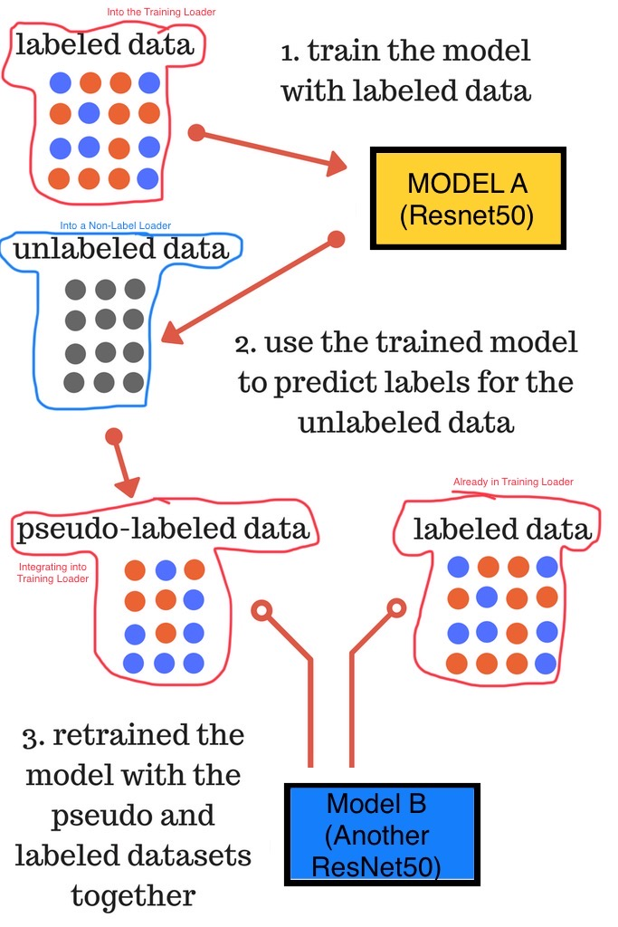
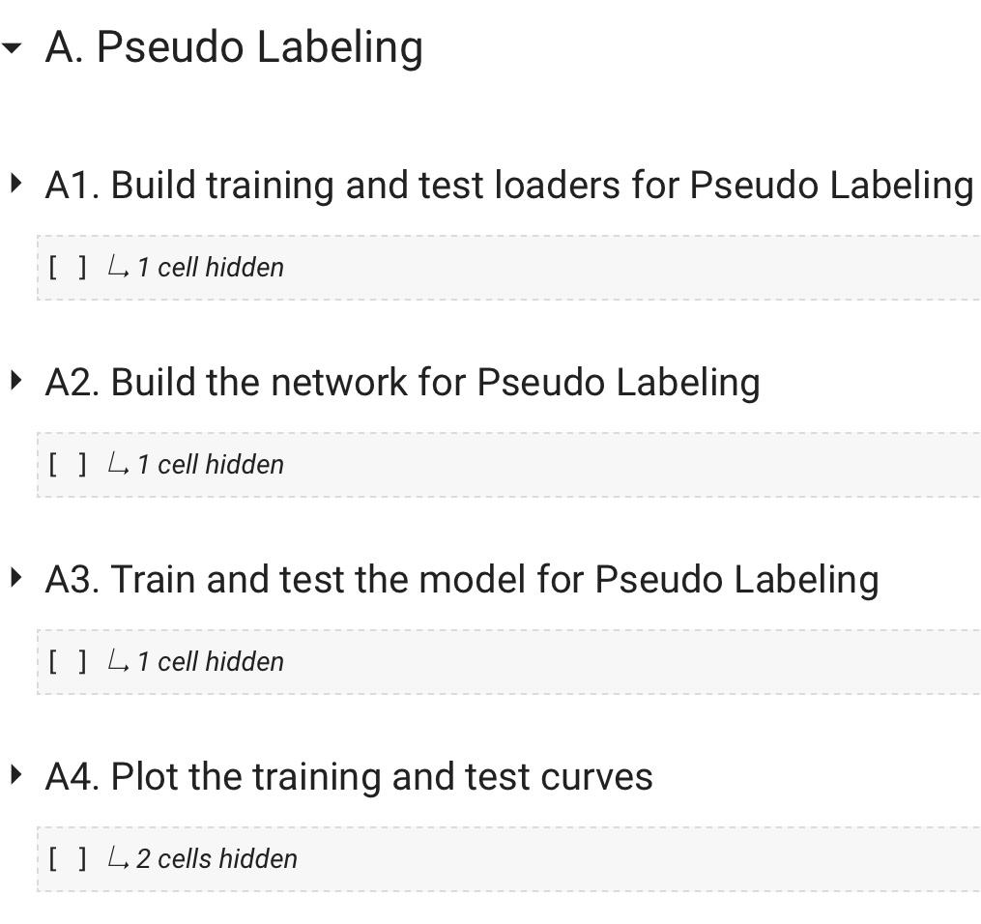
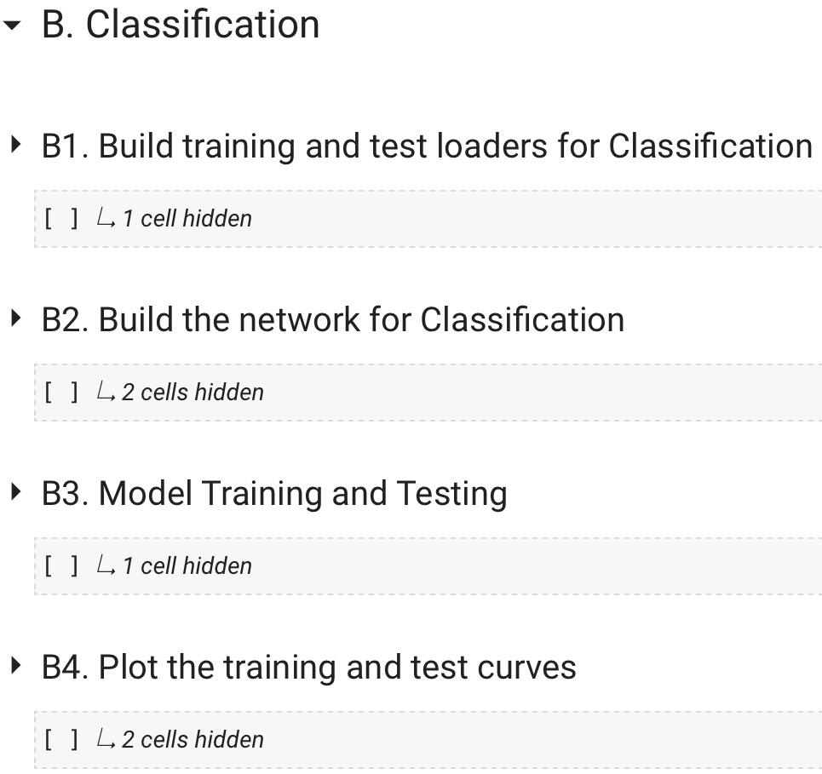
Project 1: Method Development
Image src: https://www.analyticsvidhya.com/blog/2017/09/pseudo-labelling-semi-supervised-learning-technique/

Slide 5
Project 1: Result Analysis
Experiment | #Epoch (A, B) | AUC (Last epoch of A) | Test AUC for B | Test ACC for B
Benchmark | (N/A, 10) | N/A | 77.9056% | 78.8889%
1 | (10, 10) | 74.9251 | 65.7343% | 84.4444%
2 | (10, 10) | 53.2828% | 57.3232% | 73.3333%
3 | (5, 10) | 63.3488% | 57.9475% | 78.8889%
4 | (5, 10) | 71.3675% | 73.8248% | 85.5556%

Slide 6
Project 1: Conclusion
For simplicity, no regularization parameter is given:
Performance may improve with regularization.
Overfitting issue is severe.
May require more data or make a easier model
The final result is similar between supervised and semi-supervised model

Slide 7
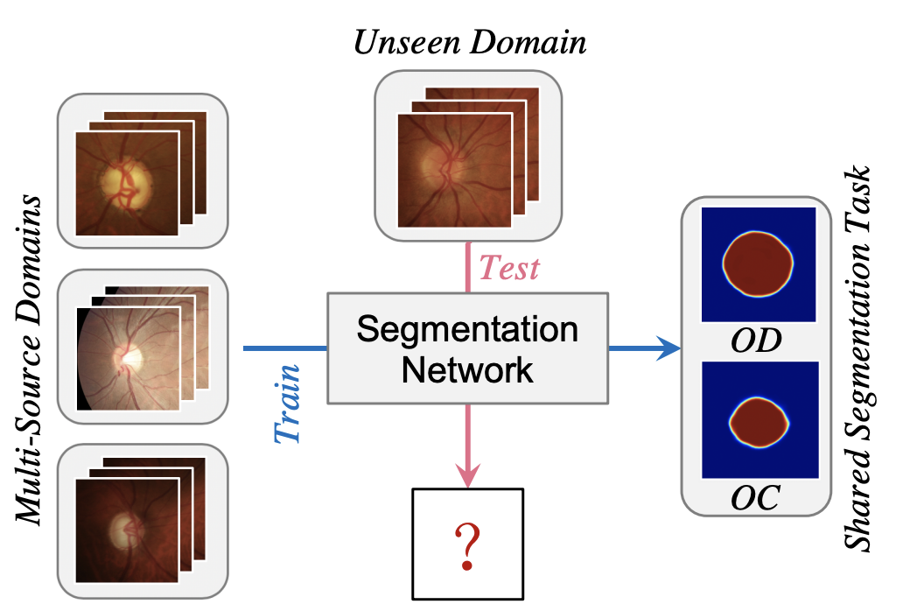
Project 2: Background Introduction
Segmentation on Fundus Images
Optic disc and cup
Domain Generalization
Perform well in unseen domain
Useful in real world
Data (With different scanners):
Domain 1: Drishti-GS (Train: 50, Test: 51)
Domain 2: RIM-ONE-r3 (Train: 99, Test: 60)
Domain 3: REFUGE (Train) (Train: 320, Test: 80)
Domain 4: REFUGE (Test) (Train: 320, Test: 80)

Slide 8
Project 2: Method Development
Domain-oriented Feature Embedding (Dofe)
Four experiment conducted:
Epoch: 80, learning rate: 0.001, model: DeeplabV3+ (include encoder and decoder)
Train | Test
Domain: 1, 2, 3 | Domain: 4
Domain: 1, 2, 4 | Domain: 3
Domain: 1, 3, 4 | Domain: 2
Domain: 2, 3, 4 | Domain: 1

Slide 9
Project 2: Result Analysis
Segmentation Performance on Optic Cup:
Test: | Domain 1 | Domain 2 | Domain 3 | Domain 4 | Average
Dice Coefficient | 0.8484 | 0.8290 | 0.8614 | 0.8808 | 0.8799
95% of Hausdorff Distance | 30.12 | 22.22 | 19.84 | 14.46 | 21.66
Average surface Distance | 15.44 | 11.56 | 9.852 | 6.627 | 10.87

Slide 10
Project 2: Result Analysis
Segmentation Performance on Optic Disc:
Test: | Domain 1 | Domain 2 | Domain 3 | Domain 4 | Average
Dice Coefficient | 0.9640 | 0.9154 | 0.9322 | 0.9332 | 0.9362
95% of Hausdorff Distance | 13.91 | 21.84 | 18.55 | 16.23 | 17.63
Average surface Distance | 6.305 | 12.31 | 9.506 | 7.47 | 8.898

Slide 11
Project 2: Conclusion
Generalization
By using domain generalization, it would be getting better performance for unseen datasets/domain.
Complexity increased
More domain models need to train
Performance Trade-off
Need to fufil all domains

